Slide 1
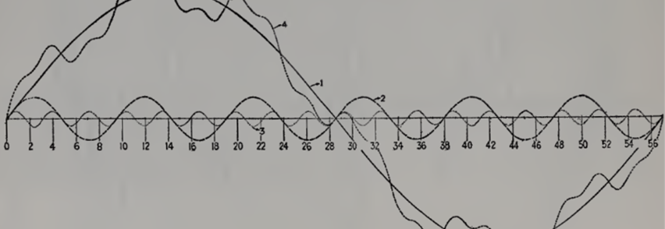
Business cycles and disequilibrium in a simple Schumpeter-Keynes model
Önder Nomaler (UNU-MERIT, nomaler@merit.unu.edu), Danilo Spinola (Birmingham City University, danilo.spinola@bcu.ac.uk), Bart Verspagen (UNU-MERIT, b.verspagen@maastrichtuniversity.nl, corresponding author)

Slide 2
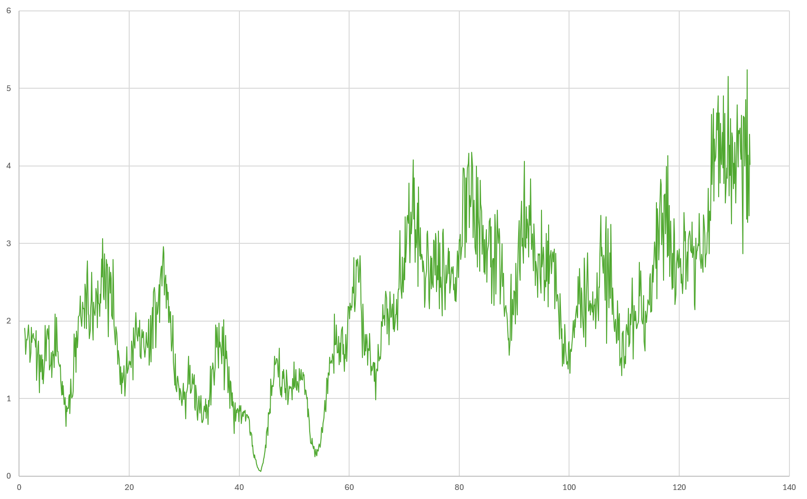
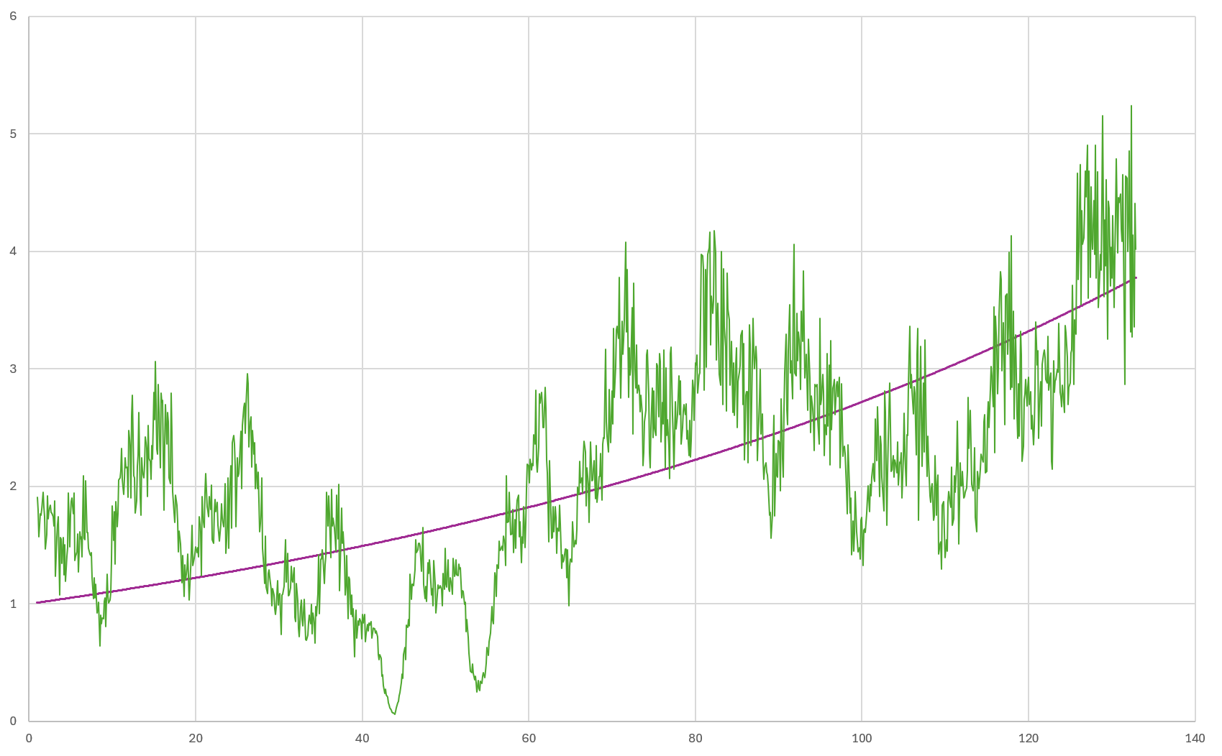
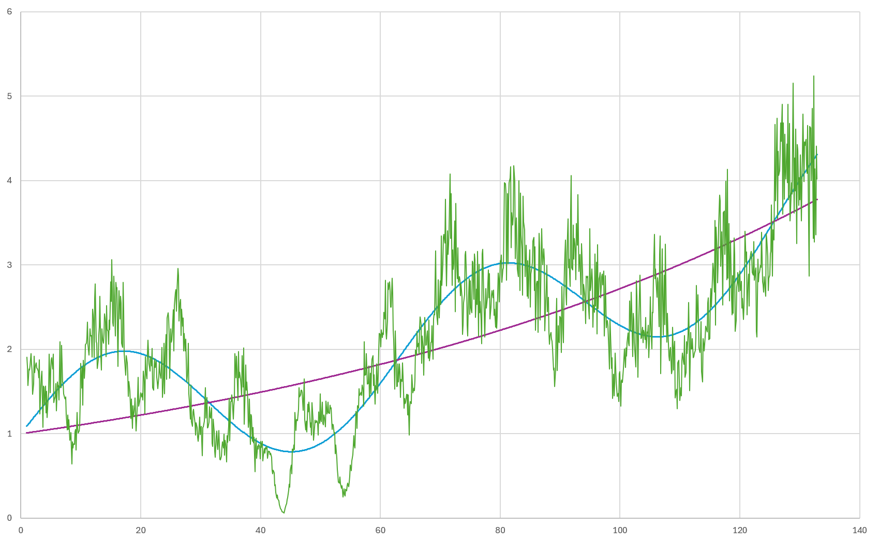
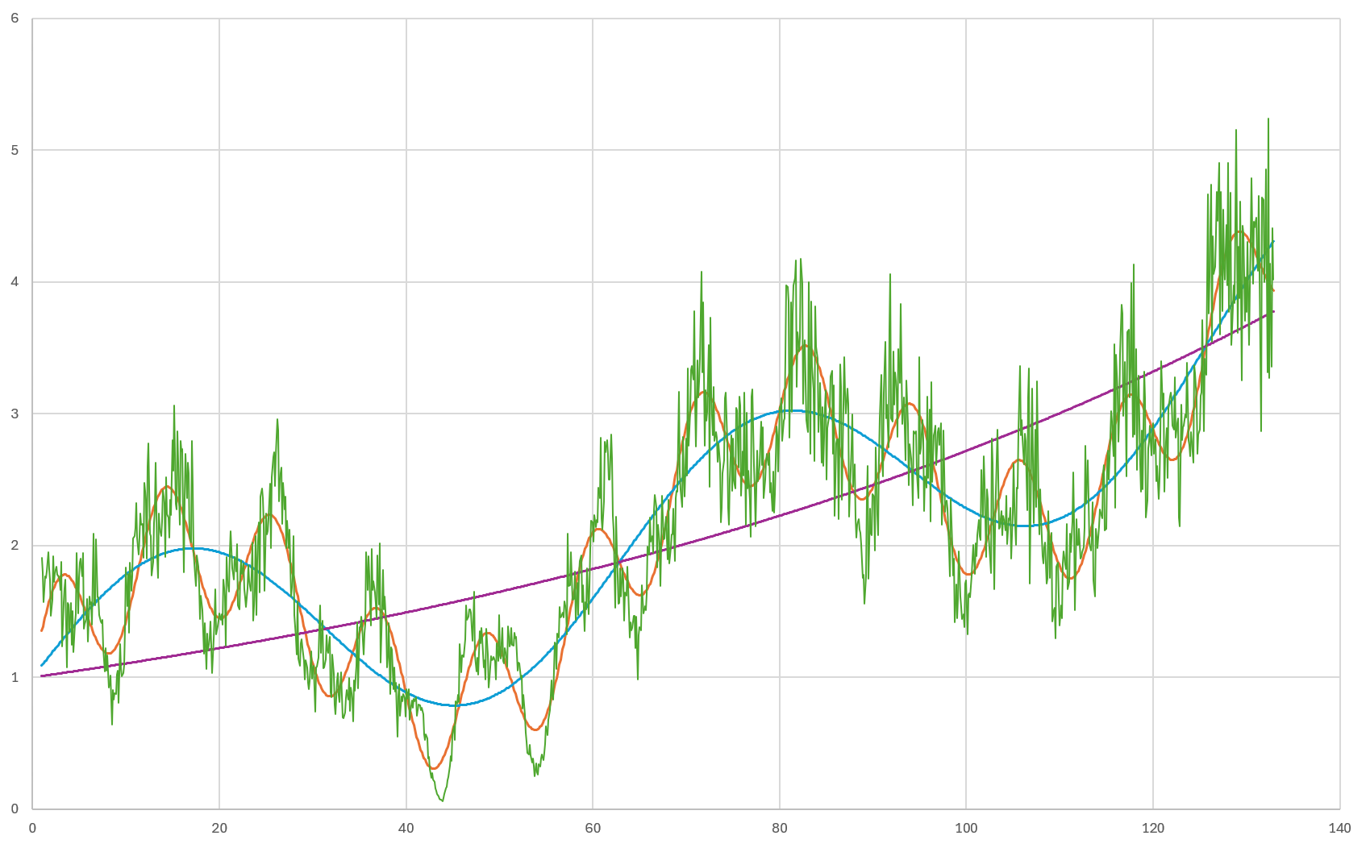

Schumpeter’s multiplicity of fluctuations

Slide 3
The aims of our paper
To go beyond just long waves and capture Schumpeter’s multiplicity of fluctuations
To do so using a formal model of Schumpeterian disequilibrium dynamics
And to do so considering the demand side (Keynes) in addition to the supply side (Schumpeter)

Slide 4
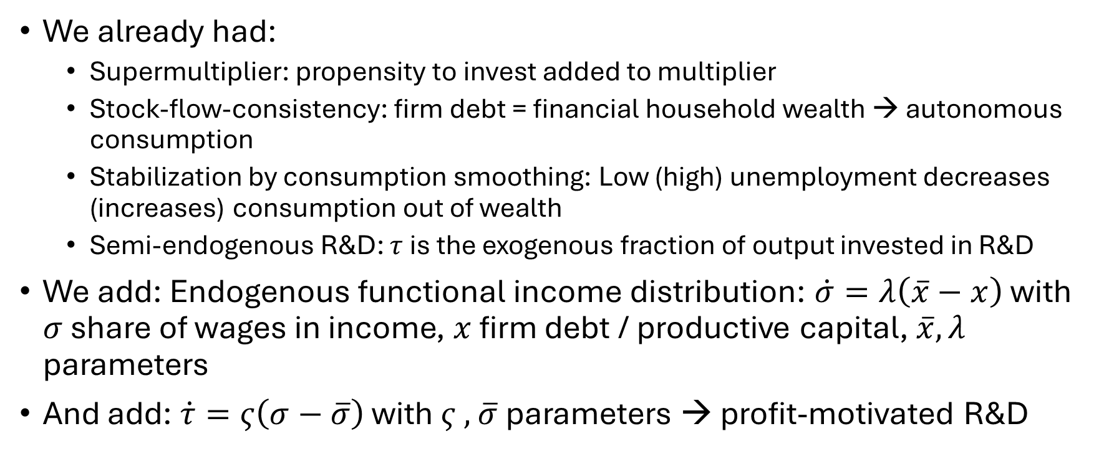
Nomaler et al., SCED → new extended model
We already had:
  Supermultiplier: propensity to invest added to multiplier
  Stock-flow-consistency: firm debt = financial household wealth → autonomous consumption
  Stabilization by consumption smoothing: Low (high) unemployment decreases (increases) consumption out of wealth
  Semi-endogenous R&D: $τ$ is the exogenous fraction of output invested in R&D
We add: Endogenous functional income distribution: $\dot{σ}=λ\left(\overline{x}−x\right)$ with $σ$ share of wages in income, $x$ firm debt / productive capital, $\overline{x},λ$ parameters
And add: $\dot{τ}=ς\left(σ−\overline{σ}\right)$ with $ς ,$ $\overline{σ}$parameters → profit-motivated R&D

Slide 5
The model has a stable steady state

Slide 6
But if we keep shocking the productivity of R&D parameter
We get what looks like a multiplicity of waves…

Slide 7
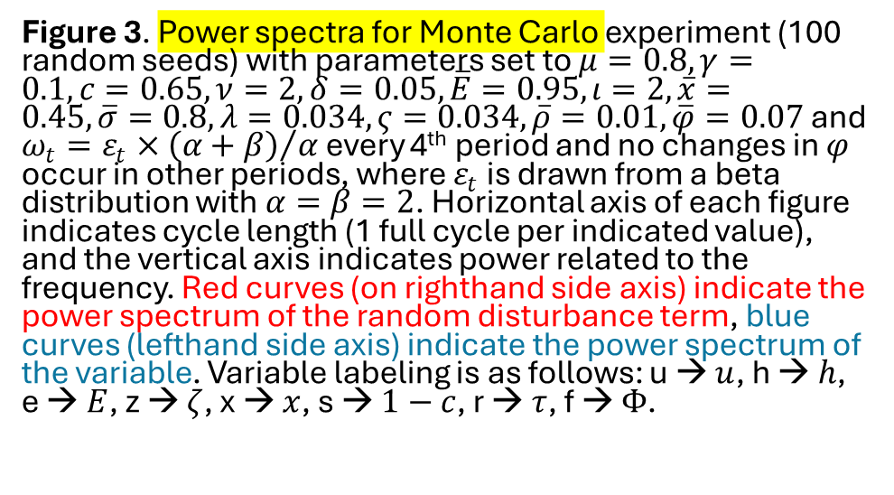
The model as a band pass filter
We feed the model with disturbances that are white noise covering waves of all lengths > 4 periods (red lines), but each variable only tunes into specific (mostly mid-length) fluctuations
Figure 3. Power spectra for Monte Carlo experiment (100 random seeds) with parameters set to $μ=0.8, γ=0.1, c=0.65, ν=2, δ=0.05, \overline{E}=0.95, ι=2, \overline{x}=0.45, \overline{σ}=0.8, λ=0.034, ς=0.034, \overline{ρ}=0.01,\overline{φ}=0.07$ and $ω_{t}=ε_{t}×{\left(α+β\right)}/α$ every 4th period and no changes in $φ$ occur in other periods, where $ε_{t}$ is drawn from a beta distribution with $α=β=2$. Horizontal axis of each figure indicates cycle length (1 full cycle per indicated value), and the vertical axis indicates power related to the frequency. Red curves (on righthand side axis) indicate the power spectrum of the random disturbance term, blue curves (lefthand side axis) indicate the power spectrum of the variable. Variable labeling is as follows: u → $u$, h → $h$, e → $E$, z → $ζ$, x → $x$, s → $1−c$, r → $τ$, f → $Φ$.

Slide 8
Which are the resonant frequencies?
Complex eigenvalues of the Jacobian at the steady state correspond to oscillatory modes of the model, e.g.
For the numerical values of the parameters that we tested, there are usually two (and sometimes just one) oscillatory modes (4 or 2 imaginary eigenvalues)
2π/imaginary part is the cycle length of the oscillatory mode, in this case 61 and 106
The real parts indicate how fast a disturbance dies out

Slide 9
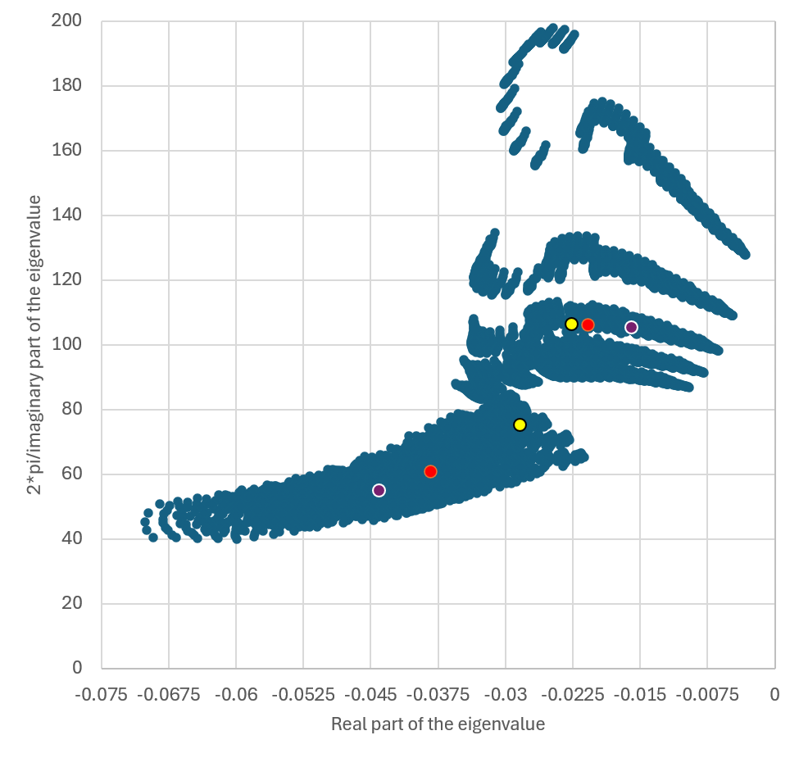
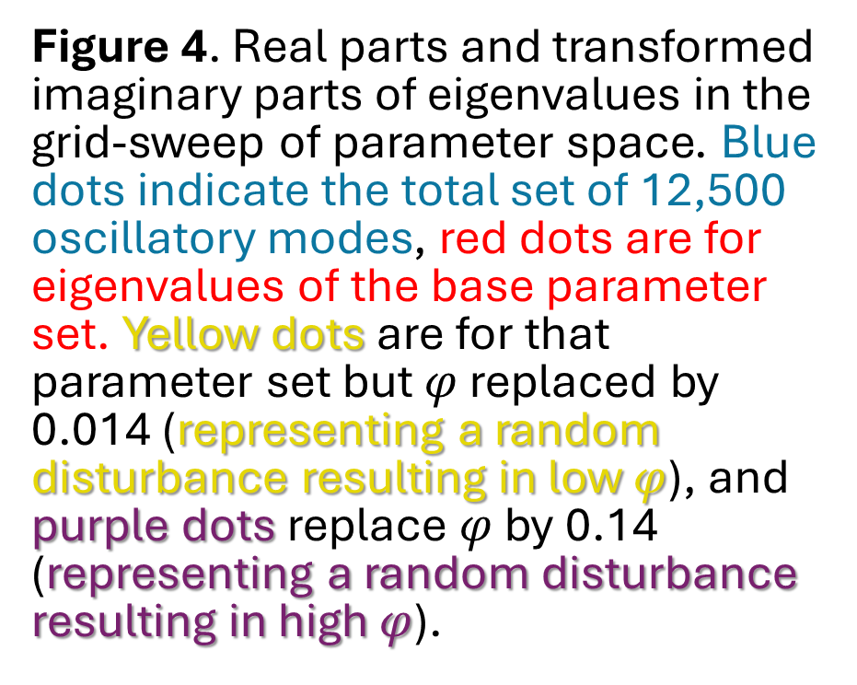
The oscillatory modes for 6,250 parameter sets
Figure 4. Real parts and transformed imaginary parts of eigenvalues in the grid-sweep of parameter space. Blue dots indicate the total set of 12,500 oscillatory modes, red dots are for eigenvalues of the base parameter set. Yellow dots are for that parameter set but $φ$ replaced by 0.014 (representing a random disturbance resulting in low $φ$), and purple dots replace $φ$ by 0.14 (representing a random disturbance resulting in high $φ$).

Slide 10
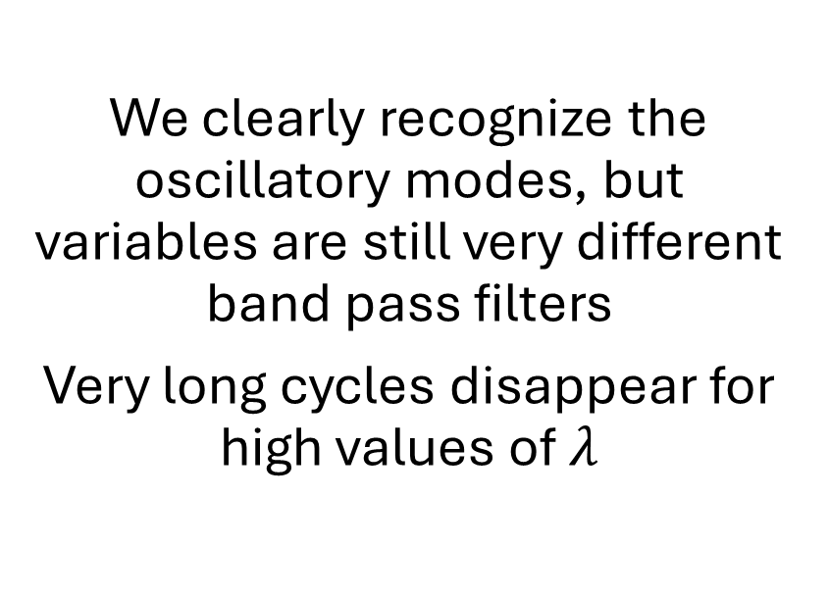
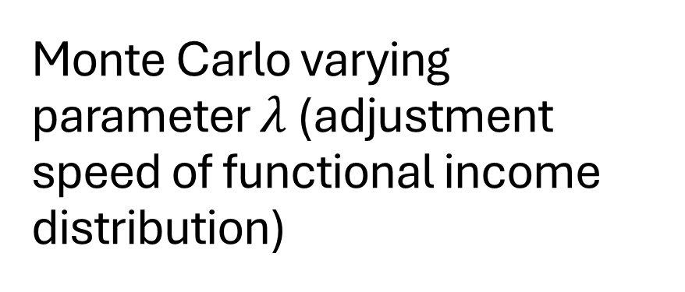
Monte Carlo varying parameter $λ$ (adjustment speed of functional income distribution)
We clearly recognize the oscillatory modes, but variables are still very different band pass filters
Very long cycles disappear for high values of $λ$

Slide 11
Conclusions and Outlook
A multitude of fluctuations, but R&D variables show the longest waves
Functional income and wealth distributions are endogenous and part of the fluctuations
We have only just begun to explore parameter space

